Slide 1
FINAL PRESENTATION & DEMO 3-SEVEN TETRIS BY .DUEL
LIM PEI YONG 36732
WILLIAM NGU WEE HONG 39322
ABDUL RAHIM BIN MOHAMAD 35282
LIM CHONG FATT 36712
HOE YOU TIEN 36249

Slide 2
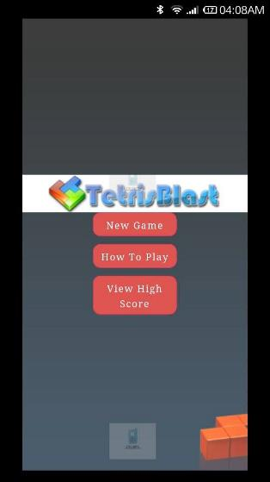
OVER VIEW OF THE PROJECT
Consist of 3 basic game options.
New Game
How To Play
View High Score

Slide 3
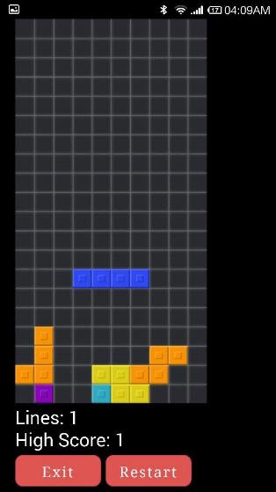
OVER VIEW OF THE PROJECT
Game based on traditional Tetris concept.
Additional mode with faster playing speed.

Slide 4
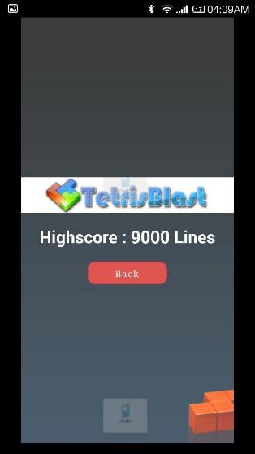
OVER VIEW OF THE PROJECT
Able to view previous game records in both modes

Slide 5
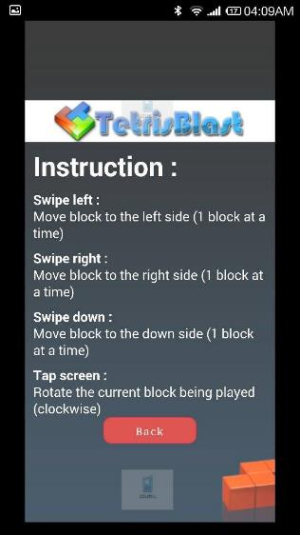
OVER VIEW OF THE PROJECT
Game instructions given in the game.

Slide 6

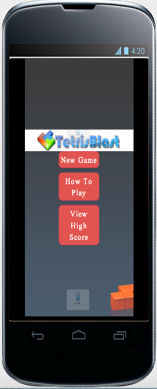
OVER VIEW OF THE PROJECT
Support for multiple platform.
iOS
Android

Slide 7
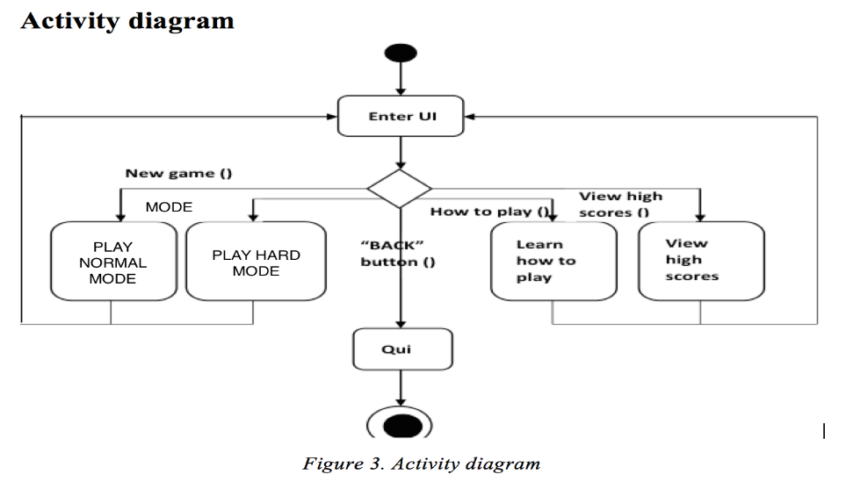
ACTIVITY DIAGRAM

Slide 8
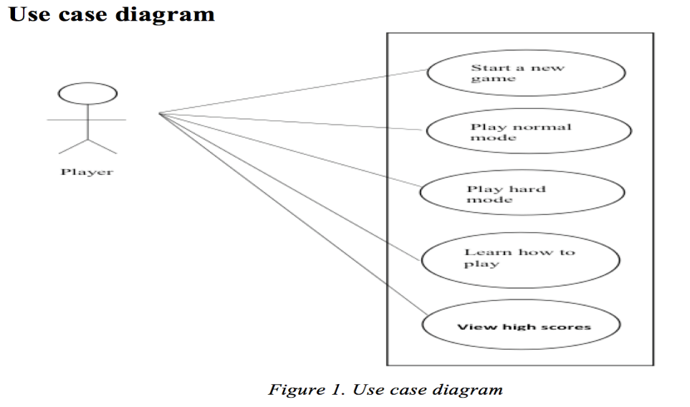
USE-CASE DIAGRAM

Slide 9
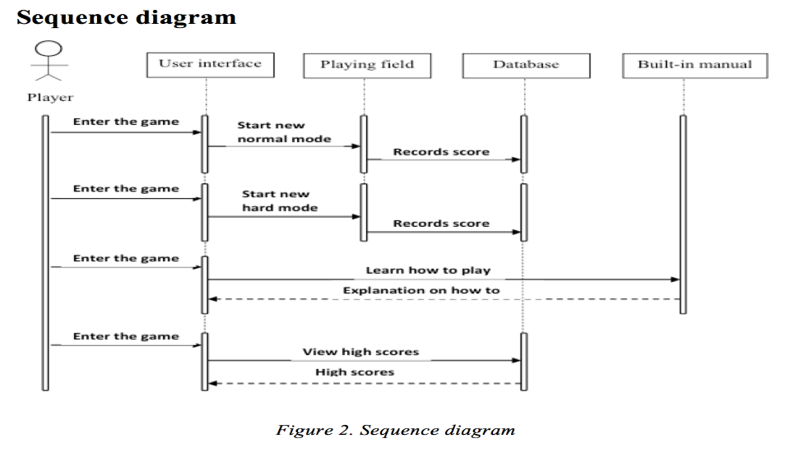
SEQUENCE DIAGRAM

Slide 10
THANK YOU
DEMO SESSION

